Slide 1
The Future of Export Finance:
How to diversify sources of liquidity?
An exporter’s perspective
Patrick Blanchard
TXF, Paris, November 12, 2013

Slide 2
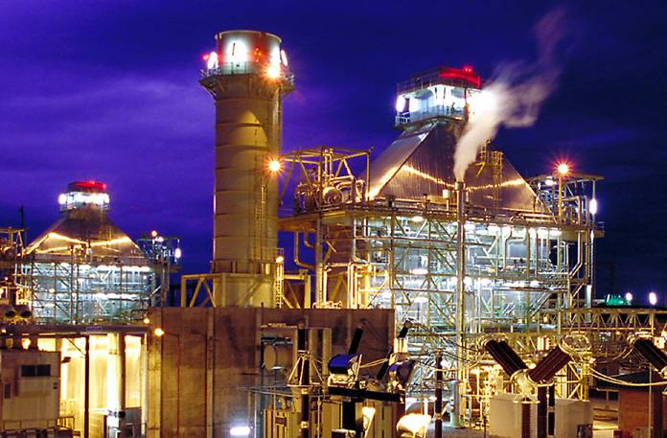
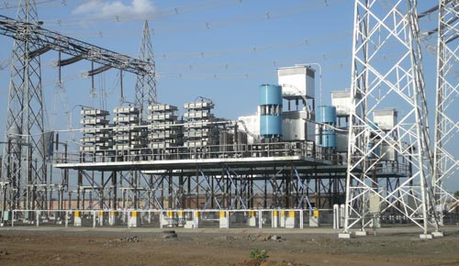
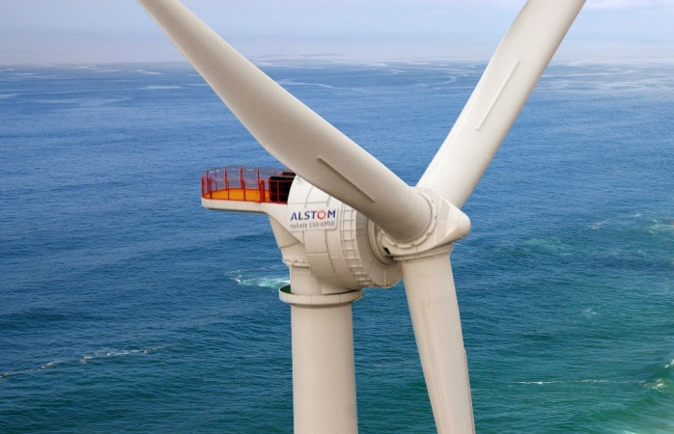
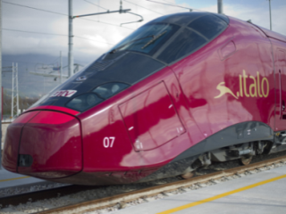
Alstom
Four Sectors
Alstom Thermal Power
Alstom Grid
Alstom Renewable Power
Alstom Transport

Slide 3
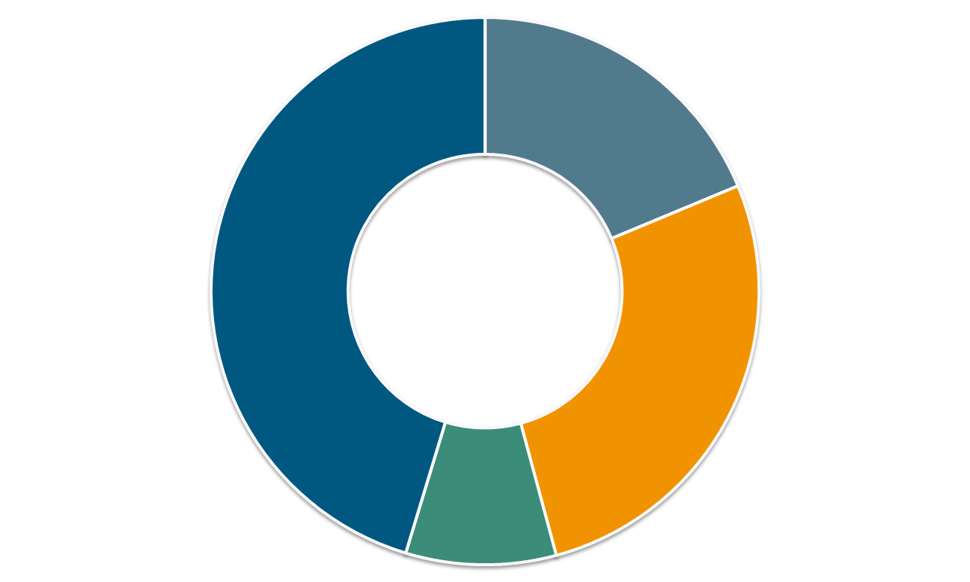
Alstom
Sales and Orders
Group Sales
Grid
€3.8b
Thermal Power 9€9.2b
Transport €5.5b
Renewable Power €1.8b
Total sales 2012/13 = €20 billion
Total orders 2012/13 = €24 billion

Slide 4
Alstom
A global footprint
Orders by regions and sectors in 2012/13
Europe
40%
North America
14%
Asia and Pacific
19%
Thermal Power
Africa and Middle-East
17%
Renewable Power
Latin America
10%
Grid
Transport
Notes:
recto
Notes

Slide 5
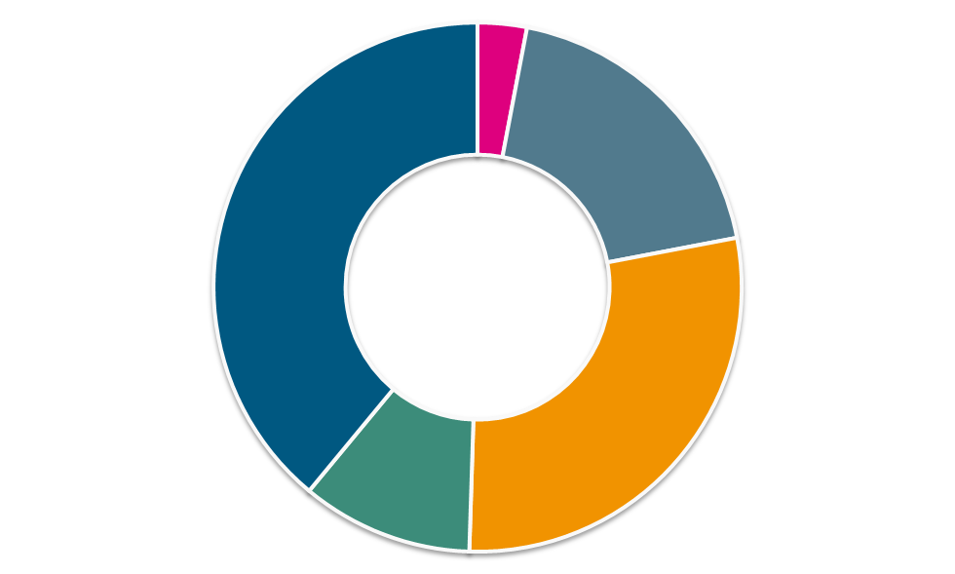
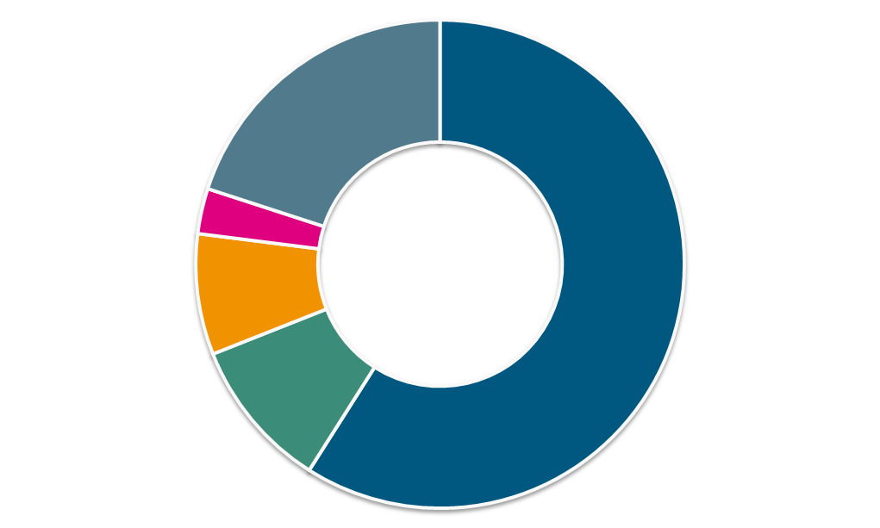
Alstom
93,000 employees worldwide in 100 countries
By sector
By region
Africa and Middle-East
3%
Corporate
3%
Asia and Pacific
20%
Thermal Power
39%
Grid
19%
Latin America
8%
Transport
28.5%
Renewable Power
10.5%
North America
10%
Europe
59%
At end of March 2013

Slide 6
Alstom
Major project/export/trade finance transactions closed in 2012/2013
Country | Project Name (Sector) | Type of Financing | Alstom contract Value in €m
Argentina | Buenos Aires Metro Line H (Transport) | Structured L/C | 124
Ecuador | Cuenca Tram (Transport) | Export finance | 71
France | Nîmes-Montpellier HSL (Transport) | Project finance, IFI | 152
Germany | Deutsche Bahn EMU/DMU (Transport) | Pre-delivery financing | 294
India | Champa (Grid) | IFI | 400
Iraq | Al-Mansurya 4xGT13 (Power) | Structured L/C | 324
Kazakhstan | KTZ Locos (Transport) | Export finance | 766
Spain | Albacete ERTMS (Transport) | Project finance, IFI | 77
UAE | Dubai Al Sufooh Tram (Transport) | Export finance | 252
UK | Carrington CCGT (Power) | Export & project finance | 257
Venezuela | Los Teques 2 Metro (Transport) | Export finance | 327
Total |  |  | €3 billion

Slide 7
Alstom
Alstom and Project & Export Finance
About 10% of Alstom’s €53 billion backlog is directly supported by ECA and PPP financing, 10 % by multilateral and other development banks, and the balance by private (corporate), public (sovereign, sub-sovereign) and other funding sources. On average 15 % of Alstom’s annual orders (excluding Services) are supported by Project & Export Finance schemes
Alstom has a long-standing relationship with export credit agencies: COFACE, SERV, HERMES, ONDD, CESCE, SACE, etc., and more recently engaged in a dialogue with KUKE of Poland and EXIAR of Russia
Alstom is often reaching ECA support limits in terms of national content requirements, due to its increasingly global industrial footprint, for both market penetration and cost competitiveness reasons
Alstom has not lost contracts for reasons directly linked to export financing. During the 2008/2011 crisis, when liquidity difficulties faced by commercial banks were acute, finding lenders was a close call, and some clients accepted increases in export credit pricing. Since then, liquidity for ECA financing has improved

Slide 8
IFIs & ECA commitments 2009/2012

Slide 9
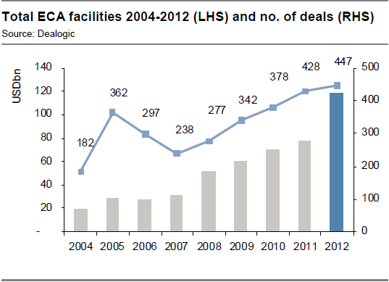
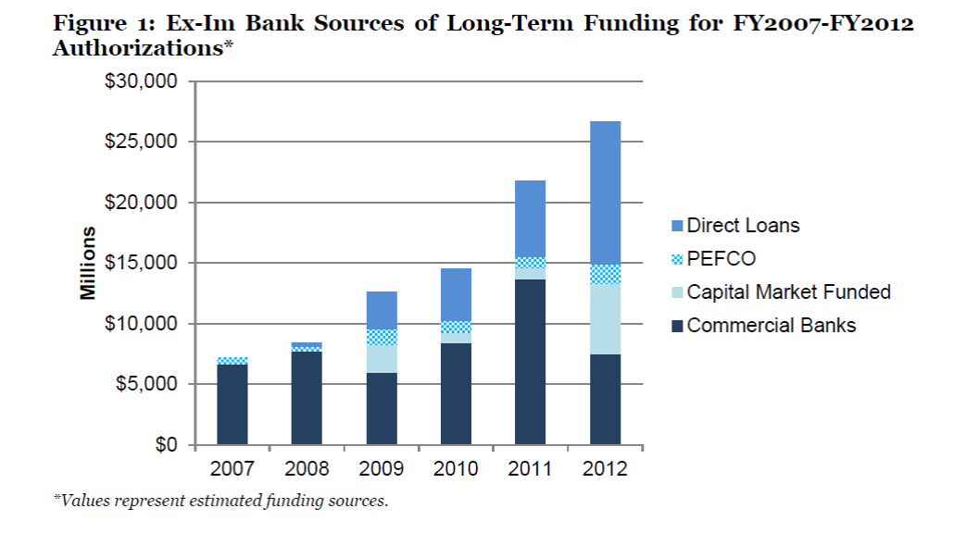
ECA financing volumes

Slide 10
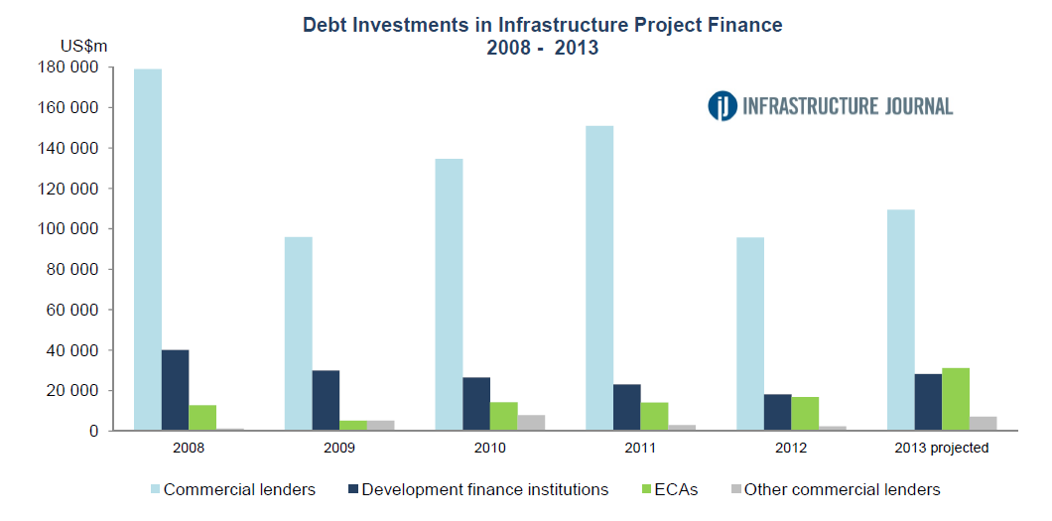
Debt Investments in Infrastructure Project Finance
ECAs:
Keen to support infrastructure
KEXIM, JBIC, China EXIM and US EXIM are most prominent
DFIs:
Political risk mitigation remains a key aspect
Innovative at supporting new technologies and new ideas (EIB: Project Bonds)
Commercial Banks :
Liquidity is improving
Focus on corporate relationships; longer tenors available for «well structured» projects

Slide 11
Recent ECA funding initiatives to improve liquidity following the global financial crisis and Basel III
Refinancing Programs
Denmark: EKF (2009)
Germany: KfW IPEX-Bank (2009) and Euler Hermes (2011)
Netherlands: Atradius (2012)
United Kingdom: UK Export Finance
Funding Programs
Finland: Finnish Export Credit Ltd (2012)
France: BPI (2012) for SMEs
Italy: Cassa Depositi e Prestiti (2011)
Norway: Export Credit Norway (2012)
United Kingdom: UK Export Finance (2012) for SMEs
Credit Enhancements: introduction of 100% unconditional guarantee
Belgium (2012), Germany (2009), Netherlands (2009), Spain (2012), France (2013)
Capital Markets
Denmark: framework agreements with pension funds to access capital markets (2010)
Germany: refinancing in capital markets through SPV or mortgage banks, as well as access to Pfandbrief (2009)

Slide 12
New Hierarchies within the OECD ECAs
Source: US Exim Bank report on export credit competition, June 2013
“Two hierarchies of competitiveness among OECD ECAs have emerged.
ECAs with direct loan programs have generally seen their direct lending volumes grow over the past four years. As commercial bank spreads rose over 100bp on long-term non-aircraft transactions, CIRR lending has become much more attractive. ECA direct lenders do not have term or capacity constraints, which provide a major advantage in large transactions. As a result, significant volumes have shifted to direct loans, and mainly to US EXIM and KEXIM.
Within the group of pure cover ECAs, the sovereign risk differentiation generated from the European sovereign debt crisis has imposed significant cost and capacity constraints on the amount of business ECAs in “higher risk” European countries are able to do. The spectrum of sovereign risk adds spreads from 50 to 400bp annually to the cost of a transaction. To mitigate this pricing impact, some ECAs have introduced capital markets funding programs (bonds, pension funds, etc.) to increase pure cover support at more competitive pricing. However, the pervasive disparity of country risk, which is a new phenomenon in the OECD export finance world, can only be reduced modestly by changing the source of funding. The differences in sovereign debt ratings in Europe in particular result in varying degrees of ability to offer comparable ECA cover because ECAs in riskier markets have higher sovereign debt costs.”

Slide 13
New Hierarchies within the OECD ECAs
Source: US Exim Bank report on export credit competition, June 2013
“ECAs with direct loan capacity are more agile and can more readily adjust to the new financing environment. Those ECAs that can lend in dollars at CIRR flat without capacity constraints have a significant competitive advantage over other ECAs, particularly for large, long-term, non-aircraft transactions (e.g. project finance).
ECAs with capacity to access non-bank funding sources (e.g., capital markets with bonds or refinancing programs) have a much easier time handling pure cover cases (like aircraft), with capital markets having a noticeable rate advantage in 2012 for larger cases.
ECAs in countries hit hard by the European sovereign debt crisis have both cost and capacity constraints that create a significant competitive disadvantage. In sum, the wide differences among commercial bank business models and the significantly un-level playing field among OECD ECAs has created an ECA world with an unprecedented amount of institutional ECA change, facing a commercial bank community with a very diverse and enlarging set of “needs” and "wants" from ECAs, and probably heading toward some fundamental debates on the rules of the road.”

Slide 14
Alstom
Diversity of financing sources in addition to ECAs and commercial banks
Alstom is keeping in close touch with IFIs which provide not only large debt volumes and long maturities, but also expertise on project prioritization, procurement, etc.
EIB is now playing a crucial role in European transport PPP as well as renewable energy project finance
National agencies, such as BNDES of Brazil and KfW of Germany are highly involved in, and supportive of, renewable energy and rail transport
Debt capital markets (pension funds, life insurers, etc.) have recently become a complementary source of funding; this said, traditional export finance banks continue to play a vital role, thanks to their international debt origination, structuring, and management capabilities
Traditional trade finance instruments (LCs, Forfaiting, etc.), including deferred payment schemes with no balance sheet impact for vendors, continue to play a key role for pre-financing and payment security purposes

Slide 15
Alstom
Innovations Alstom would like to see in the ECAs offering
Export credit bonds combining pre-financing and refinancing, committed at commencement date of a contract, could be quite useful, as is already the case for aircraft. For exporters, the key is to secure contract funding from NTP up until project acceptance. The combination of such a pre-financing (off-balance sheet for exporters) and refinancing solutions should be explored given that clients are increasingly requiring delayed payments at delivery/project acceptance, which negatively impact the exporters’ balance sheets and cash position
Alstom is often reaching the limit of ECA support in terms of national content, due to its increasingly global manufacturing footprint. Alstom would thus welcome:
The creation of a EU–wide export credit agency and of a global reinsurance mechanism for EU ECAs in coordination with national ECAs:
EU/EIB could credit enhance the fronting European ECAs given their AAA ratings
This would make intra-EU sourcing more flexible, thus avoiding complex multi-sourcing ECA pure cover arrangements with diverse national content policies
Eligibility of a reasonable quantum of non-EU content
The harmonization of the process for applying and fixing CIRR rates between the various national authorities in the EU

Slide 16
Alstom
Innovations Alstom would like to see in the ECAs offering
The creation of EU and/or French direct lending entities to support Alstom as a “European champion” (52,000 employees; exports from Europe > 1/3 of orders) or a “French champion” (18,000 employees; exports from France > 50 % of orders); this would enable us to:
Compete more effectively in emerging countries (e.g. Central Asia, India) where our competitors benefit from such financial support (US Exim Bank, China Development Bank, KfW, JBIC, EDC); indeed, Alstom is missing opportunities given that pure cover ECA financing is not competitive any longer
Address lack of liquidity from pure cover ECA providers for jumbo deals (such as nuclear power plants); current commercial bank market capacity is estimated at about €3 billion for a single transaction
The amendment of OECD Arrangement for Export Credit for Rail:
Loan maturity should reflect the life span of the underlying assets (minimum 15 years)
This would reduce the impact of debt service on clients’ budgets
This would be warranted by the positive environmental and social impact of rail compared to other means of transportation
The launch by EIB of the Africa Energy Guaranteed Fund in partnership with the African Trade Insurance Company

